Slide 1

Retail Sales Forecasting
Dylan C Neal
Springboard Data Science Career Track
09/03/20

Slide 2

Why Forecast Sales?
Financial Planning
Resource Allocation
Relevant to Shareholders

Slide 3

Background
Mistakes can get expensive!
 | Walmart | Costco
Stores in USA as of Dec 2019 | 4,756 | 546
Annual Sales | $524.0B | $152.7B
Annual Sales per Store | $110.2M | $279.7M
Weekly Sales per Store | $2.1M | $5.4M

Slide 4
Task – Sales Modeling
45 Stores
99 Departments per Store
~3 Years of Weekly Sales Data
Construct Predictive Model for Weekly Sales Forecasting

Slide 5
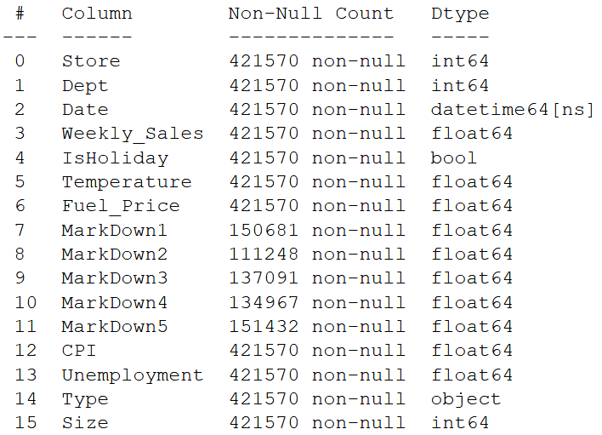
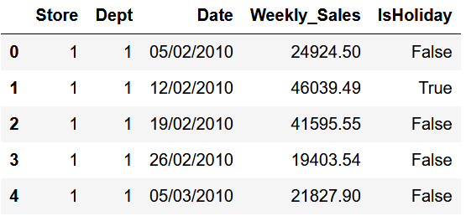
Data Wrangling

Slide 6
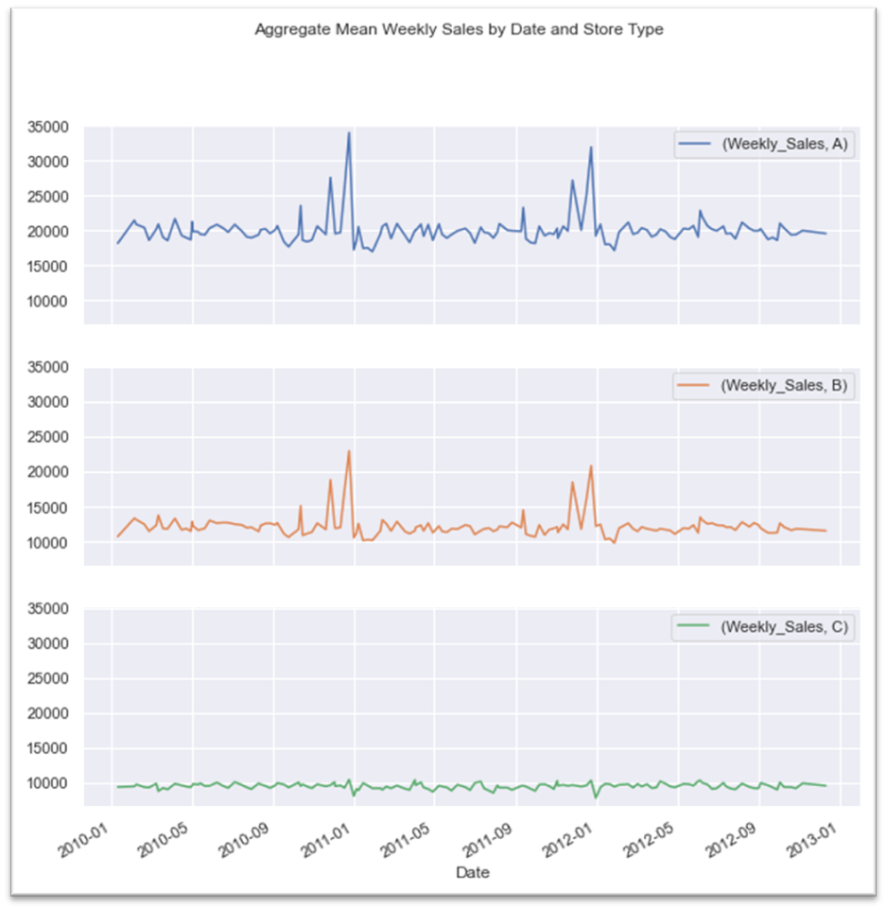
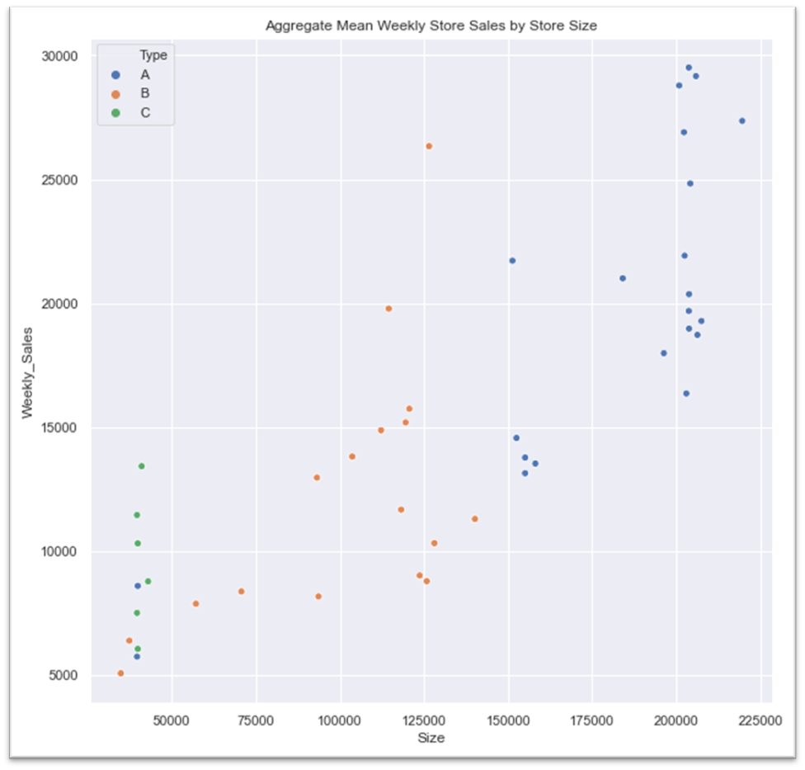
Exploratory Data Analysis

Slide 7
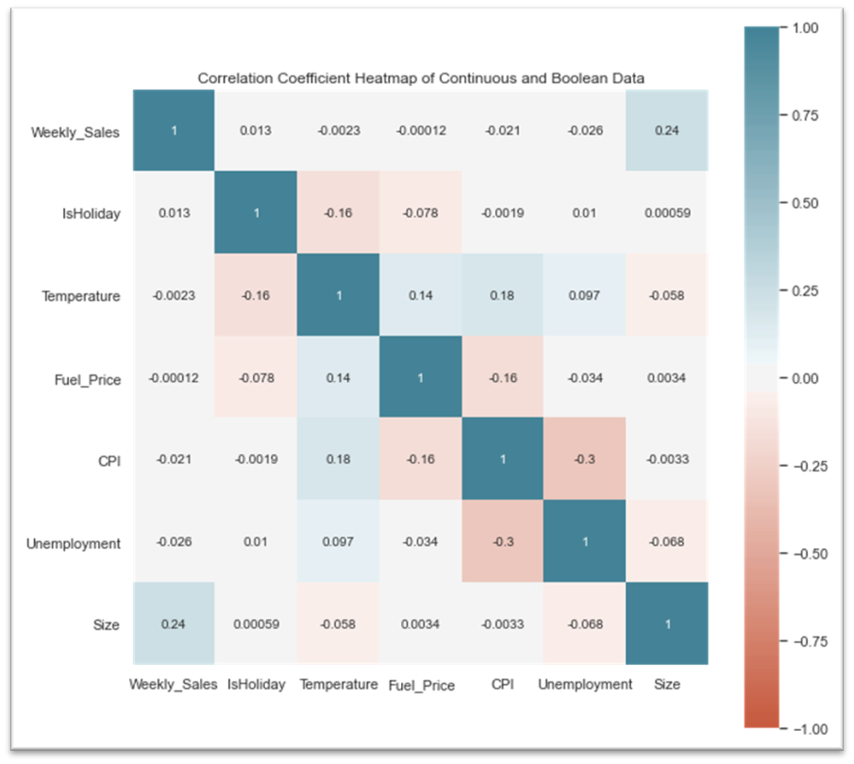
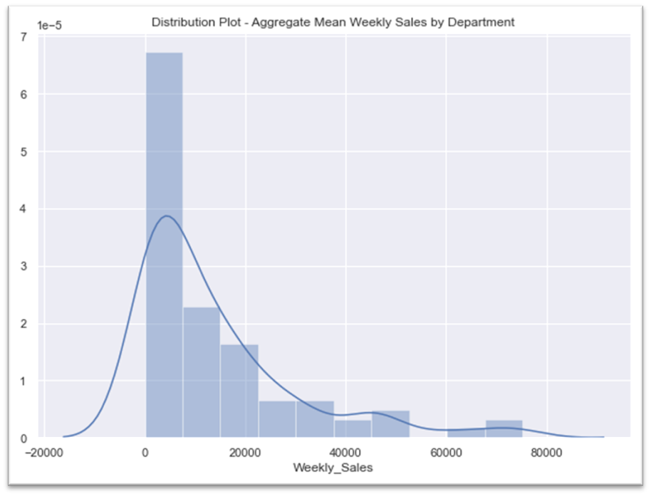
Exploratory Data Analysis

Slide 8
Thoughts
Biggest Impactors:
Store
Department
Date
Store Type
Size
Approach:
Model Separately by Store Type
Traditional vs Time-Series Methods

Slide 9
Pre-Processing
Extract Month & Week
Drop Markdowns
Create Dummy Features
Split Data By Type
Time-Series Train Test Split
Scale Continuous Features
Generate Walk-Forward Cross-Validation Segments

Slide 10
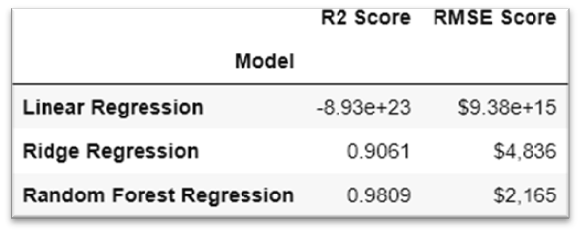
Modeling – CV - Store Type 0 (C)

Slide 11
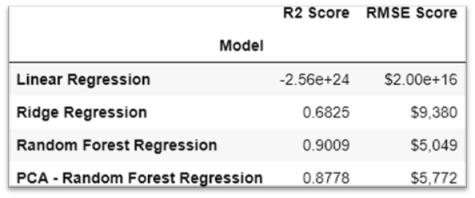
Modeling – CV - Store Type 1 (B)

Slide 12
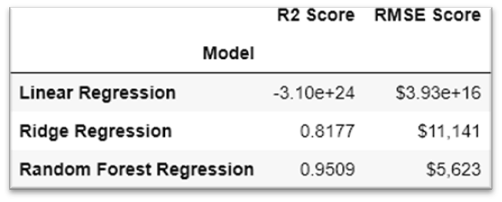
Modeling – CV - Store Type 2 (A)

Slide 13
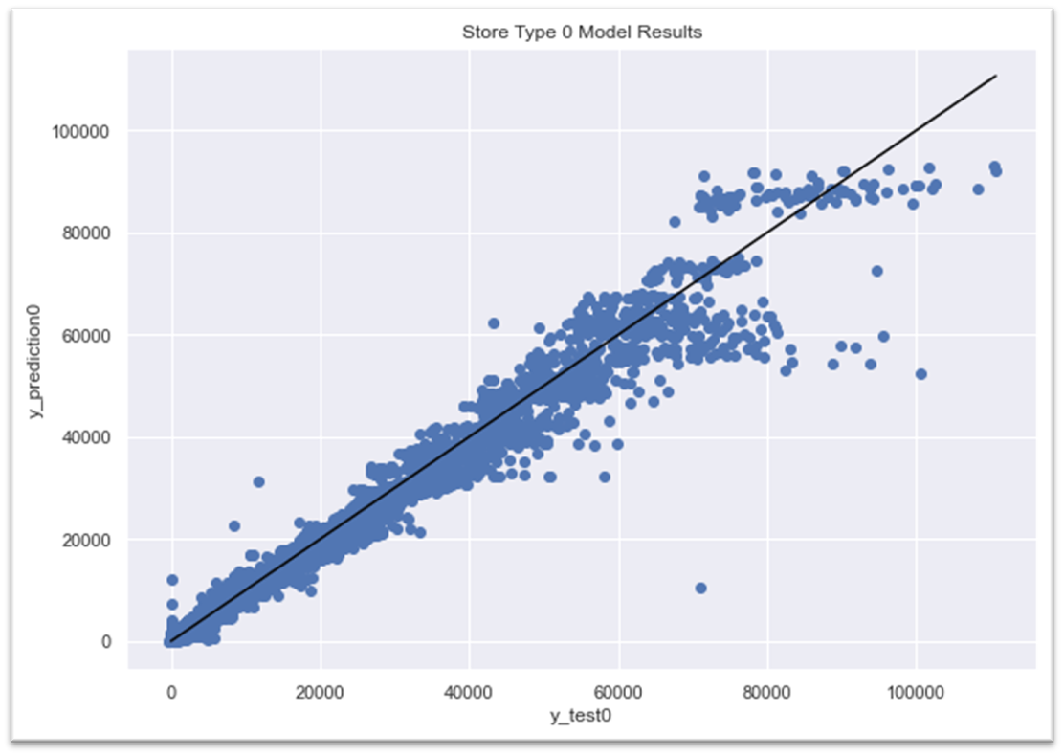
Results – Store Type 0 (C)
Random Forest Regressor
Hyperparameters:
max_depth = 80
min_samples_split = 10
min_samples_leaf = 1
max_features = ‘auto’
R² Score = 0.9787
RMSE Score = $2,393

Slide 14
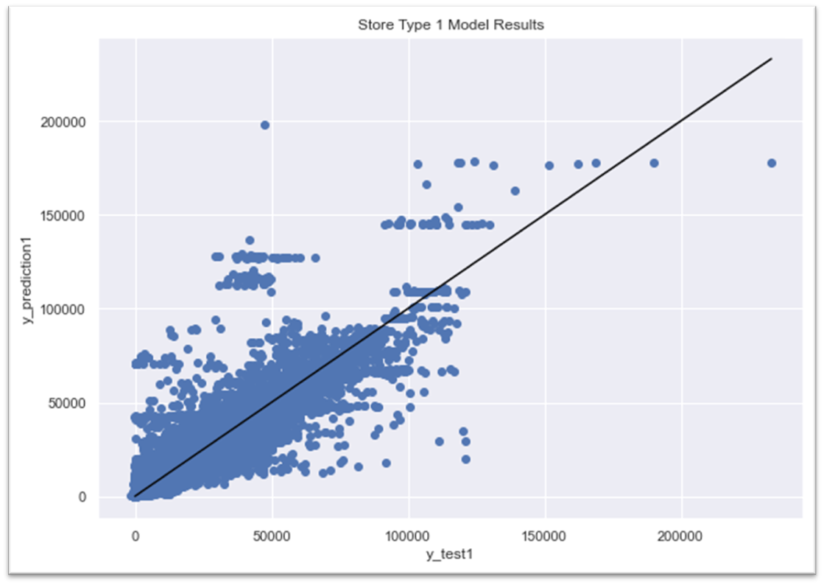
Results – Store Type 1 (B)
Random Forest Regressor
Hyperparameters:
max_depth = 80
min_samples_split = 35
min_samples_leaf = 1
max_features = ‘auto’
R² Score = 0.8403
RMSE Score = $6,329

Slide 15
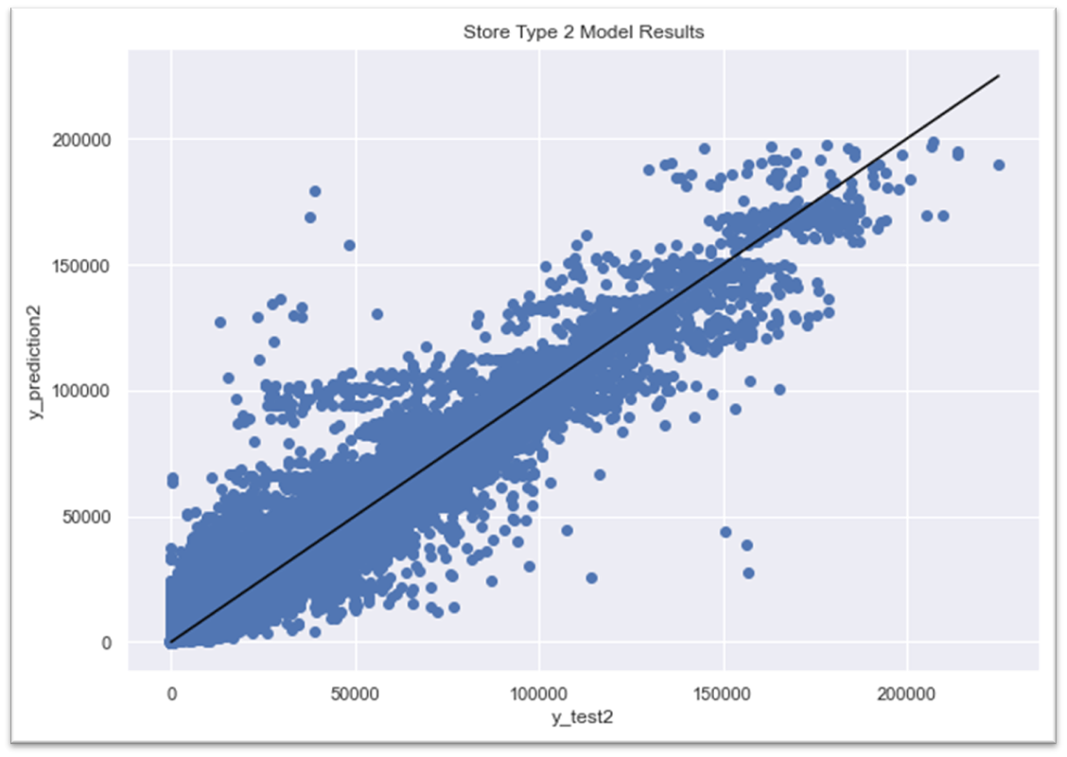
Results – Store Type 2 (A)
Random Forest Regressor
Hyperparameters:
max_depth = 100
min_samples_split = 5
min_samples_leaf = 1
max_features = ‘auto’
R² Score = 0.9370
RMSE Score = $6,543

Slide 16

Final Thoughts
Collect more data
Model by size bins rather than store type
Consider time-series modeling approaches like ARIMA

